Slide 1

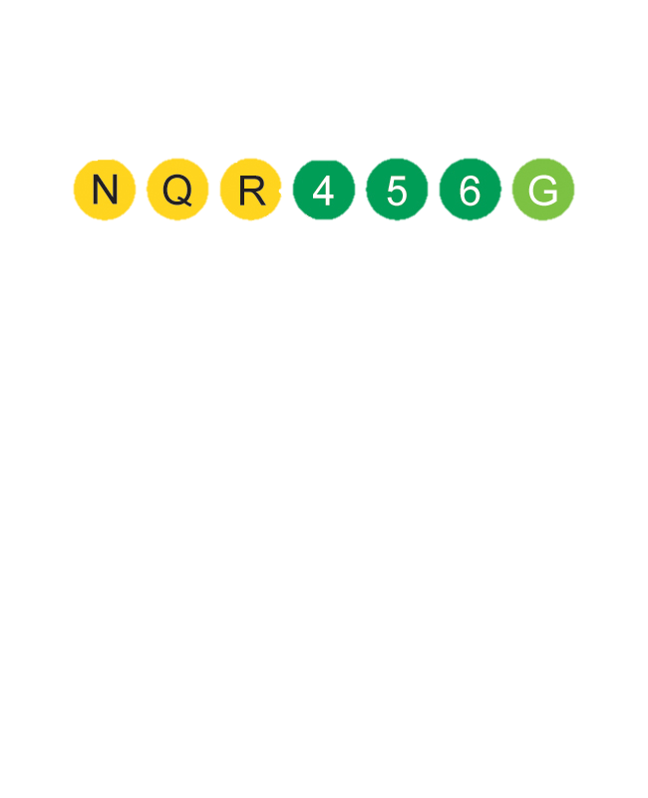

MTA Turnstile Exploratory Data Analysis
Liveboard Advertising Pricing
Cecilia Bell

Slide 2
Issue
Question
Across MTA stations, OutFront Media has a network of liveboards: digital advertising boards.
Given that liveboard advertisement spaces are available for purchase at different stations, at different times, and on different days, the pricing of these advertisement spaces can be optimized based on the foot traffic of the stations.
What stations and on what days and times could OutFront Media increase the pricing of their MTA advertising spaces in the year ahead?
Notes:
* Digital advertising boards that are often arranged as a triptych and allow full motion or static video content

Slide 3
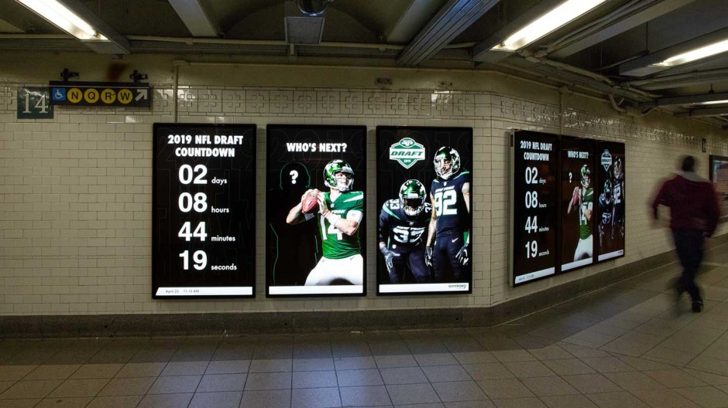

Slide 4

Data
MTA turnstile data
Jan – March 2019
Jan – March 2021
Tools
SQL
Pandas
Matplotlib
Notes:
Since the client is interested in the year ahead, looked at both pre and during Covid data, to offer a current and normalized picture of subway usage.

Slide 5
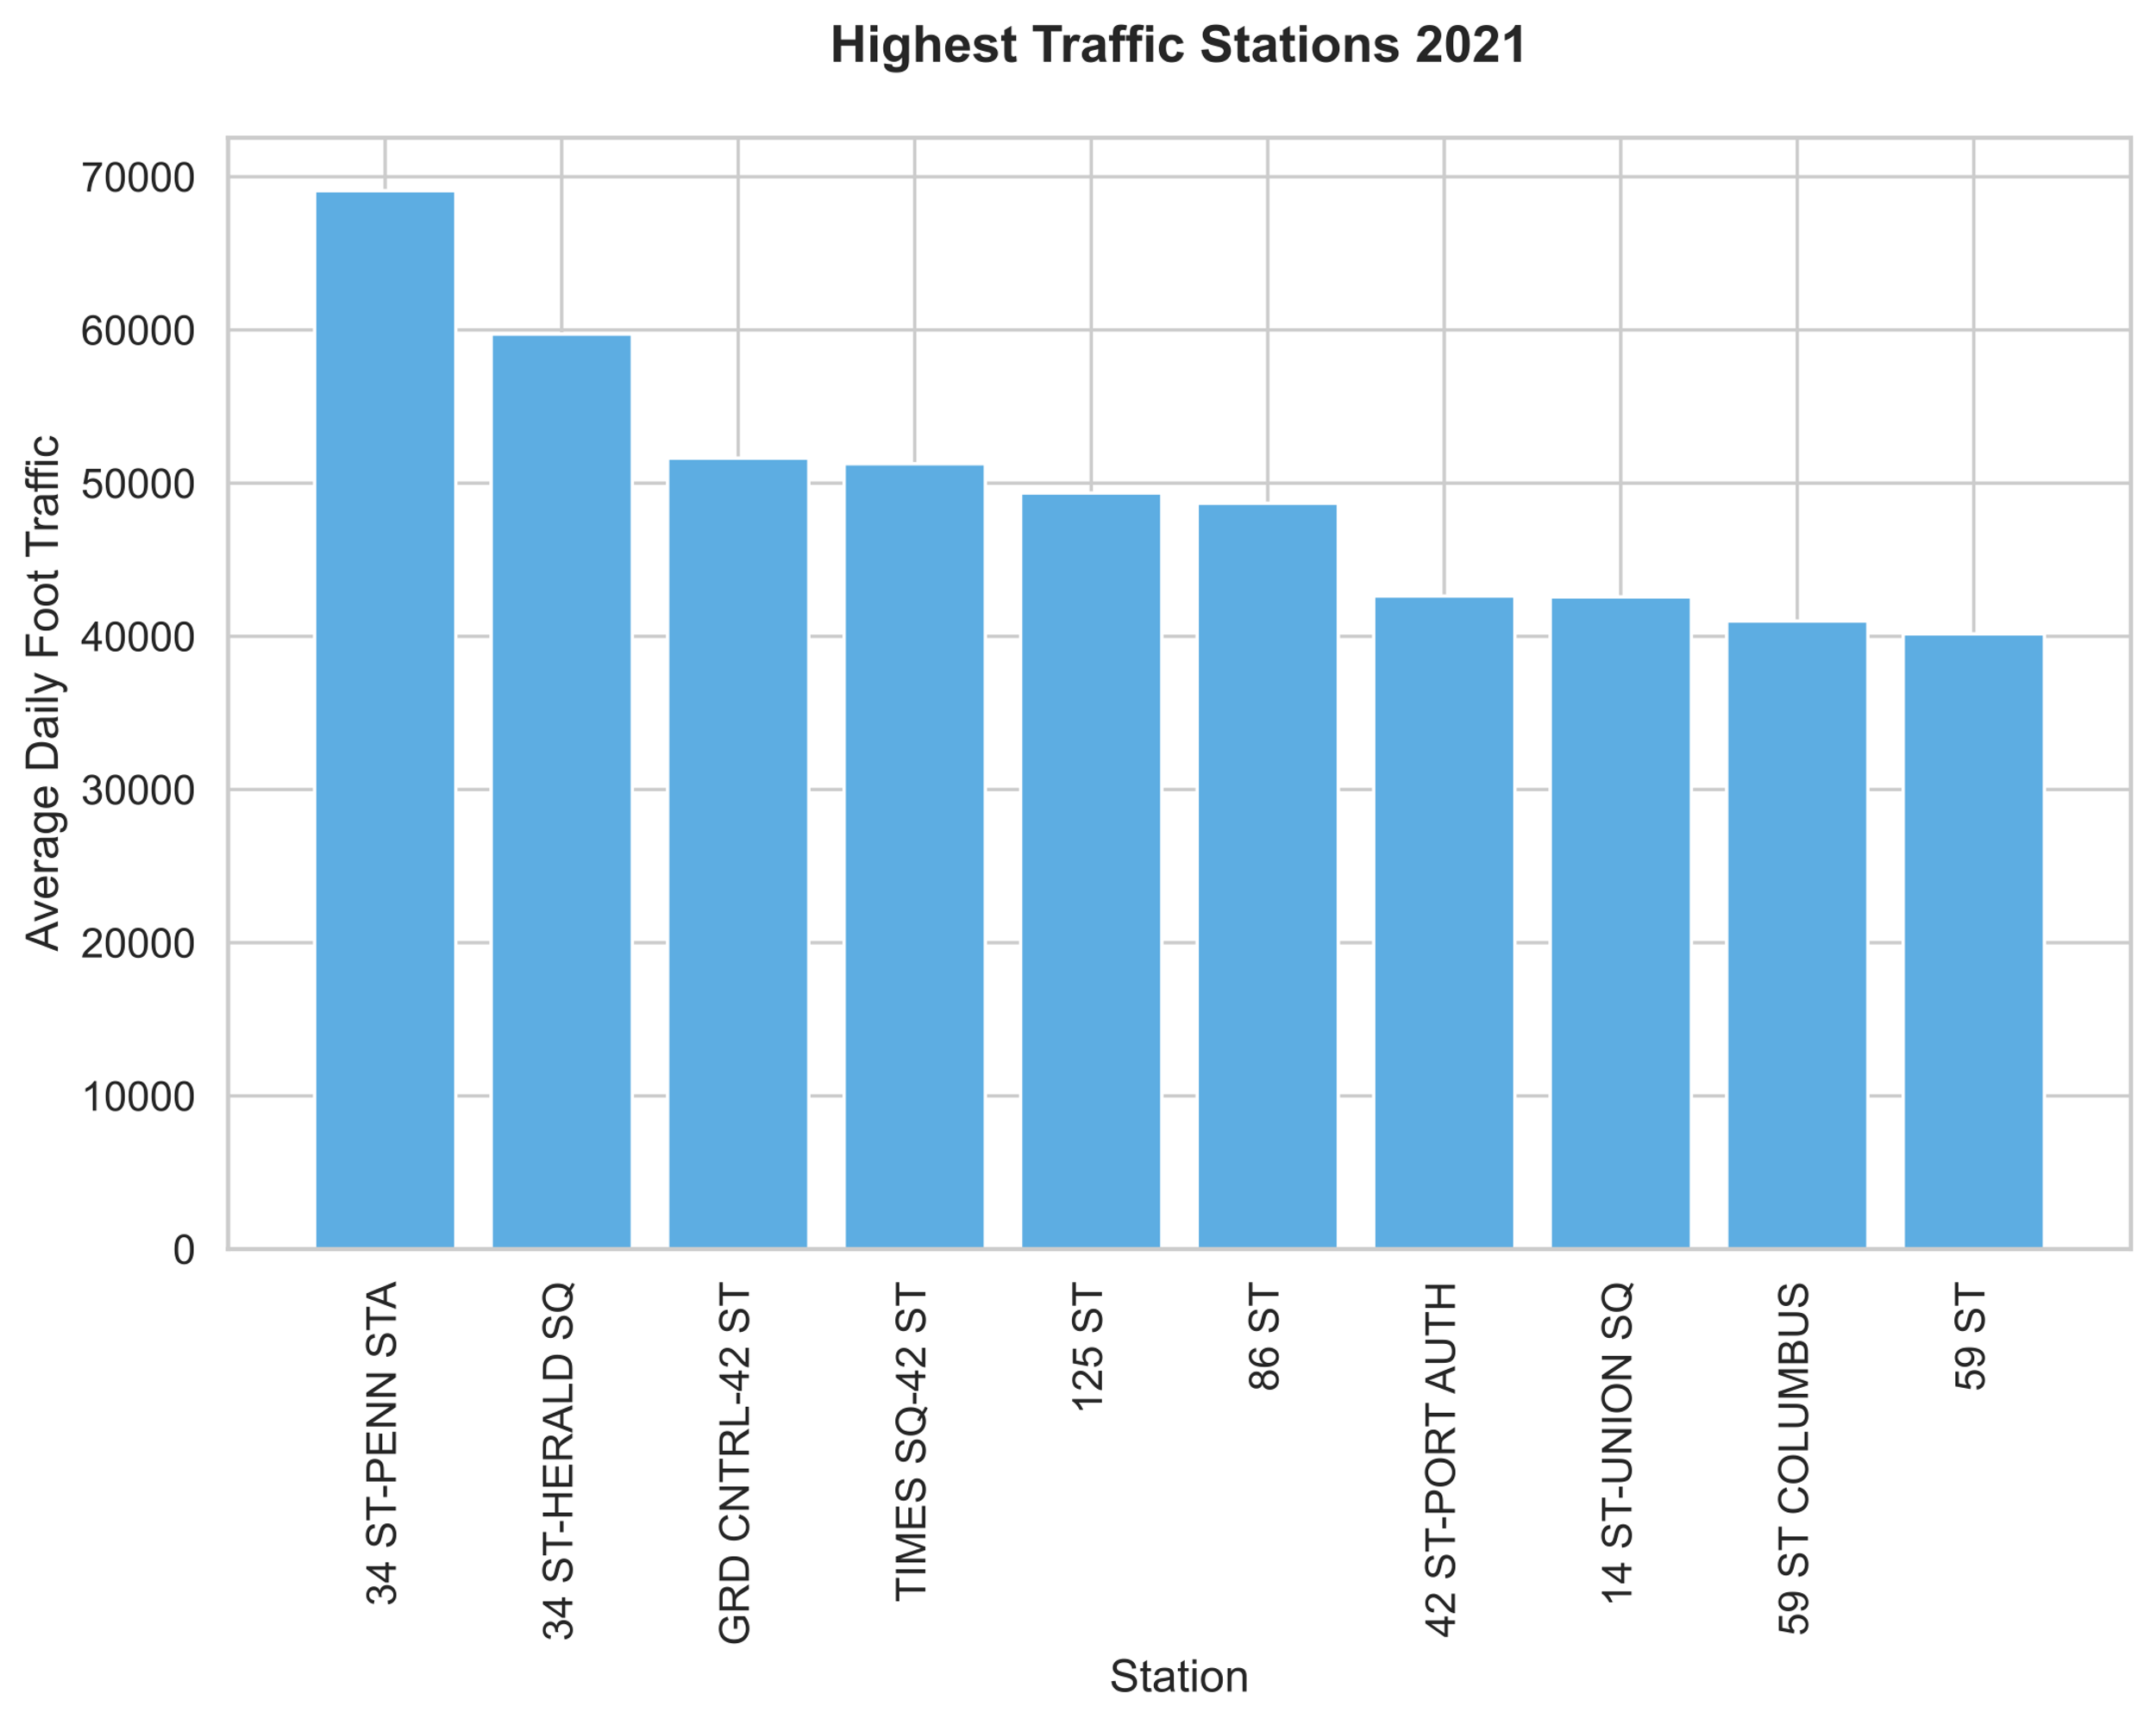
Analysis
Highest Traffic Stations
Foot traffic: sum of turnstile entries and exits

Slide 6
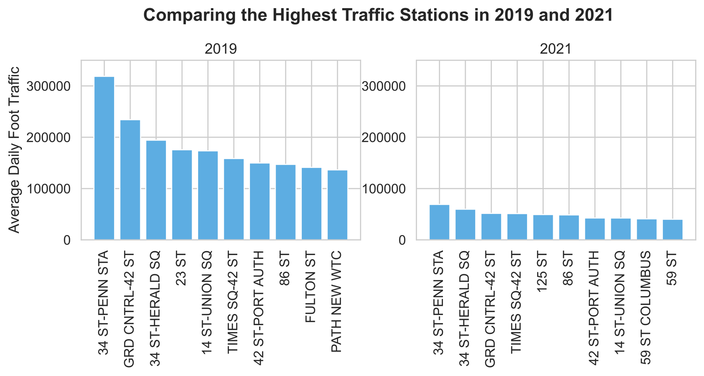
Notes:
Penn station remains the station with the highest foot traffic / the busiest station
Grand Central and 34 St Herald Sq also remain high in the ranks
Overall, traffic clearly declined significantly

Slide 7
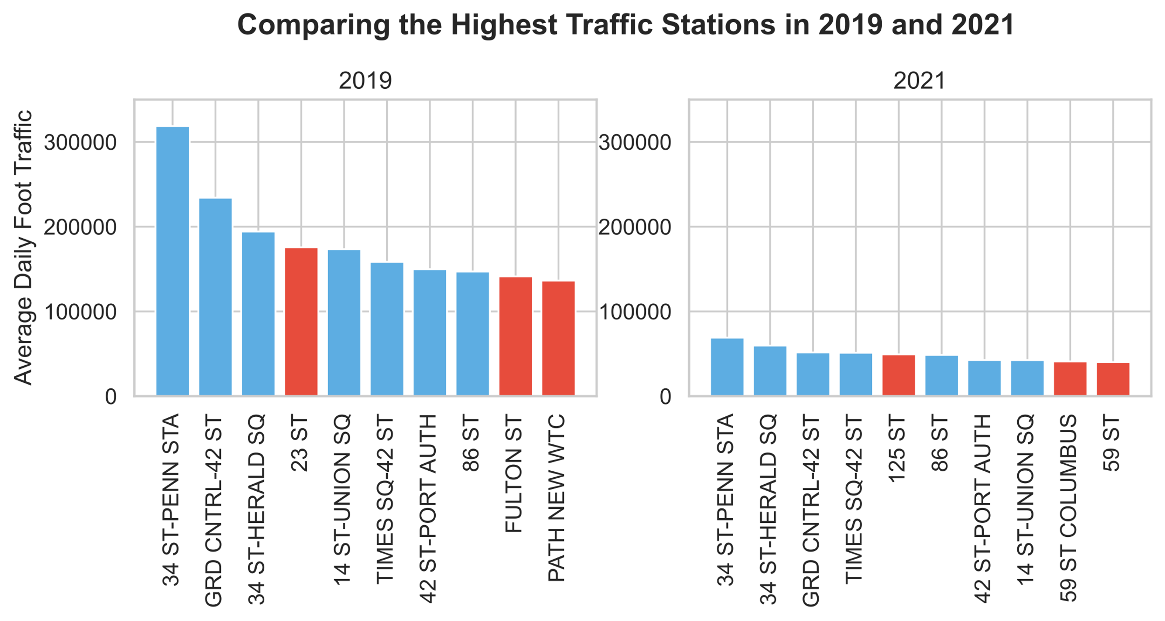

Slide 8
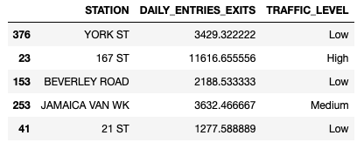

Slide 9
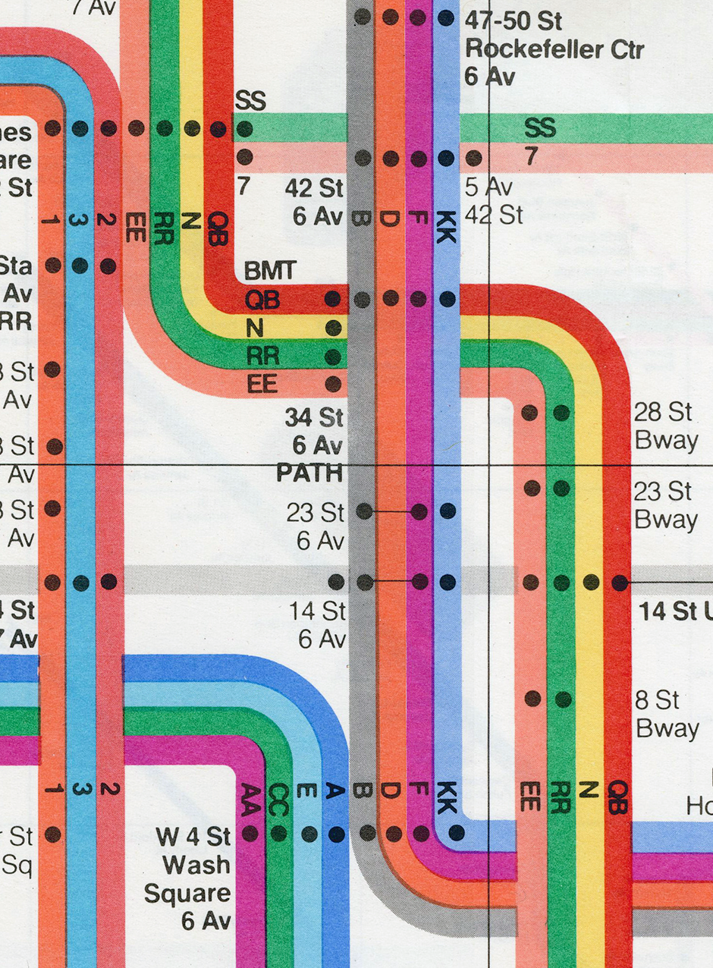
Insights
Highest Traffic Stations
Stations in major business hubs like Fulton St have seen a relatively high reduction in foot traffic during the pandemic
Less central Manhattan stations like Harlem 125 St have seen a relative increase in foot traffic during the pandemic
Consider increasing pricing of ad spaces in Manhattan stations located in non-commercial areas that are currently seeing high traffic

Slide 10
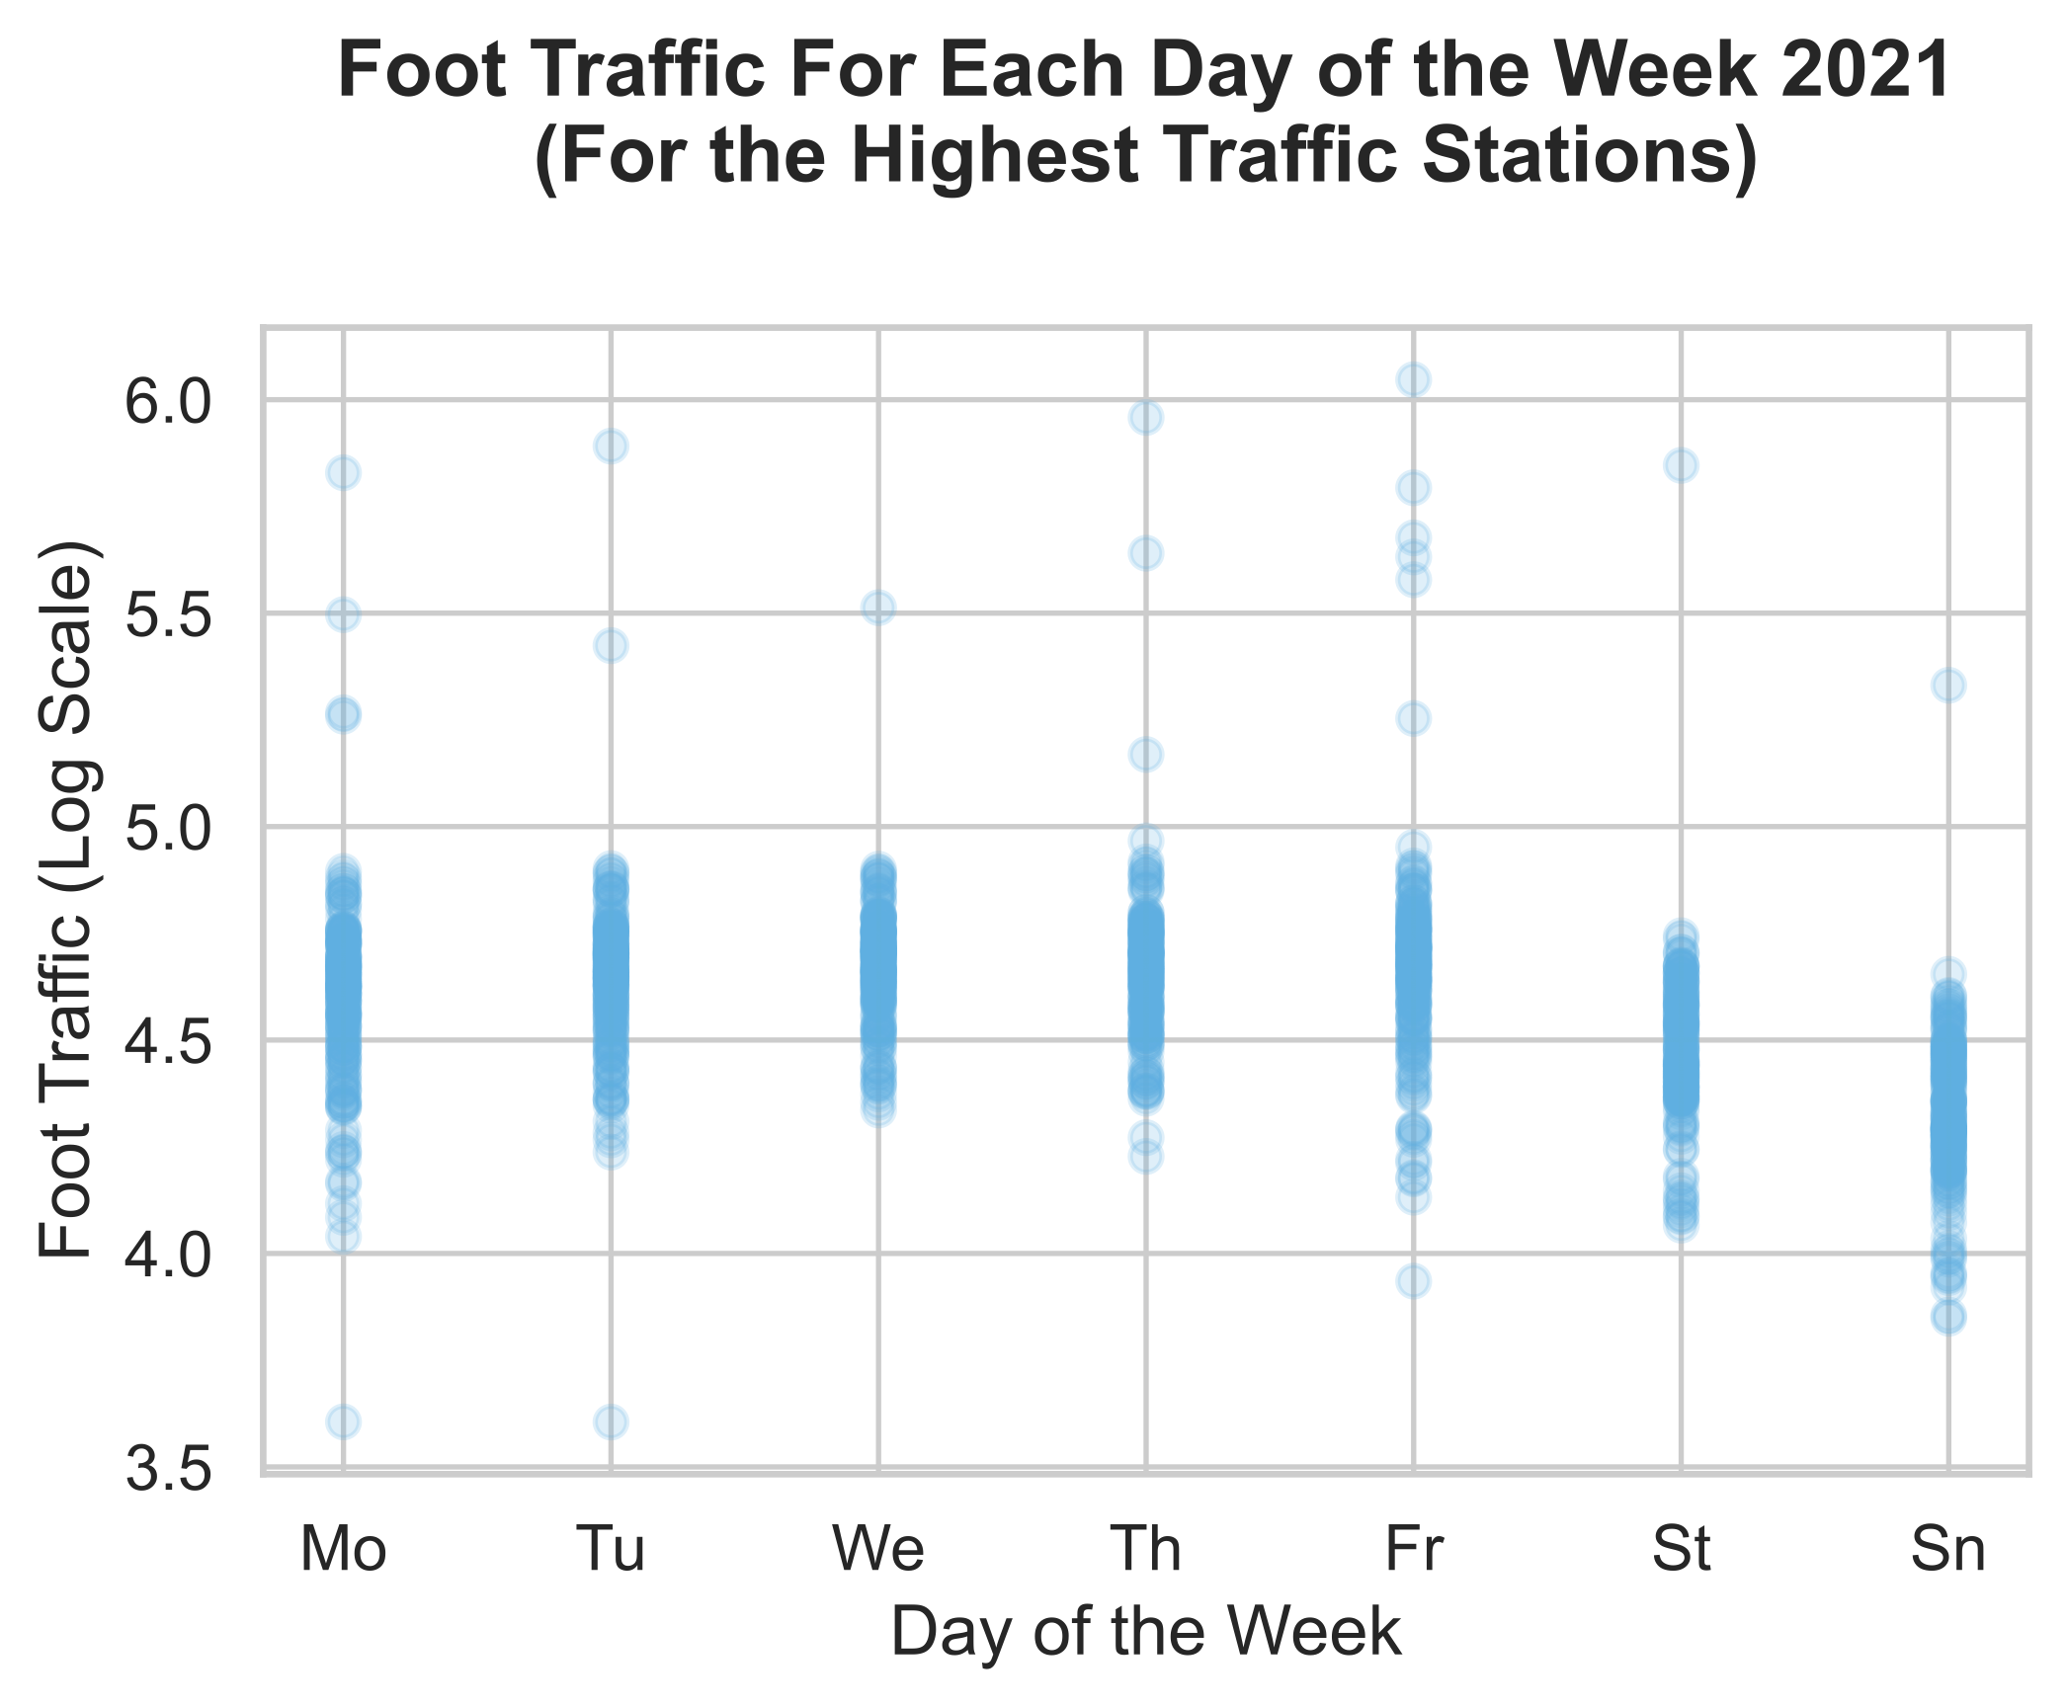
Analysis
Highest Traffic Days
Foot traffic: sum of turnstile entries and exits

Slide 11
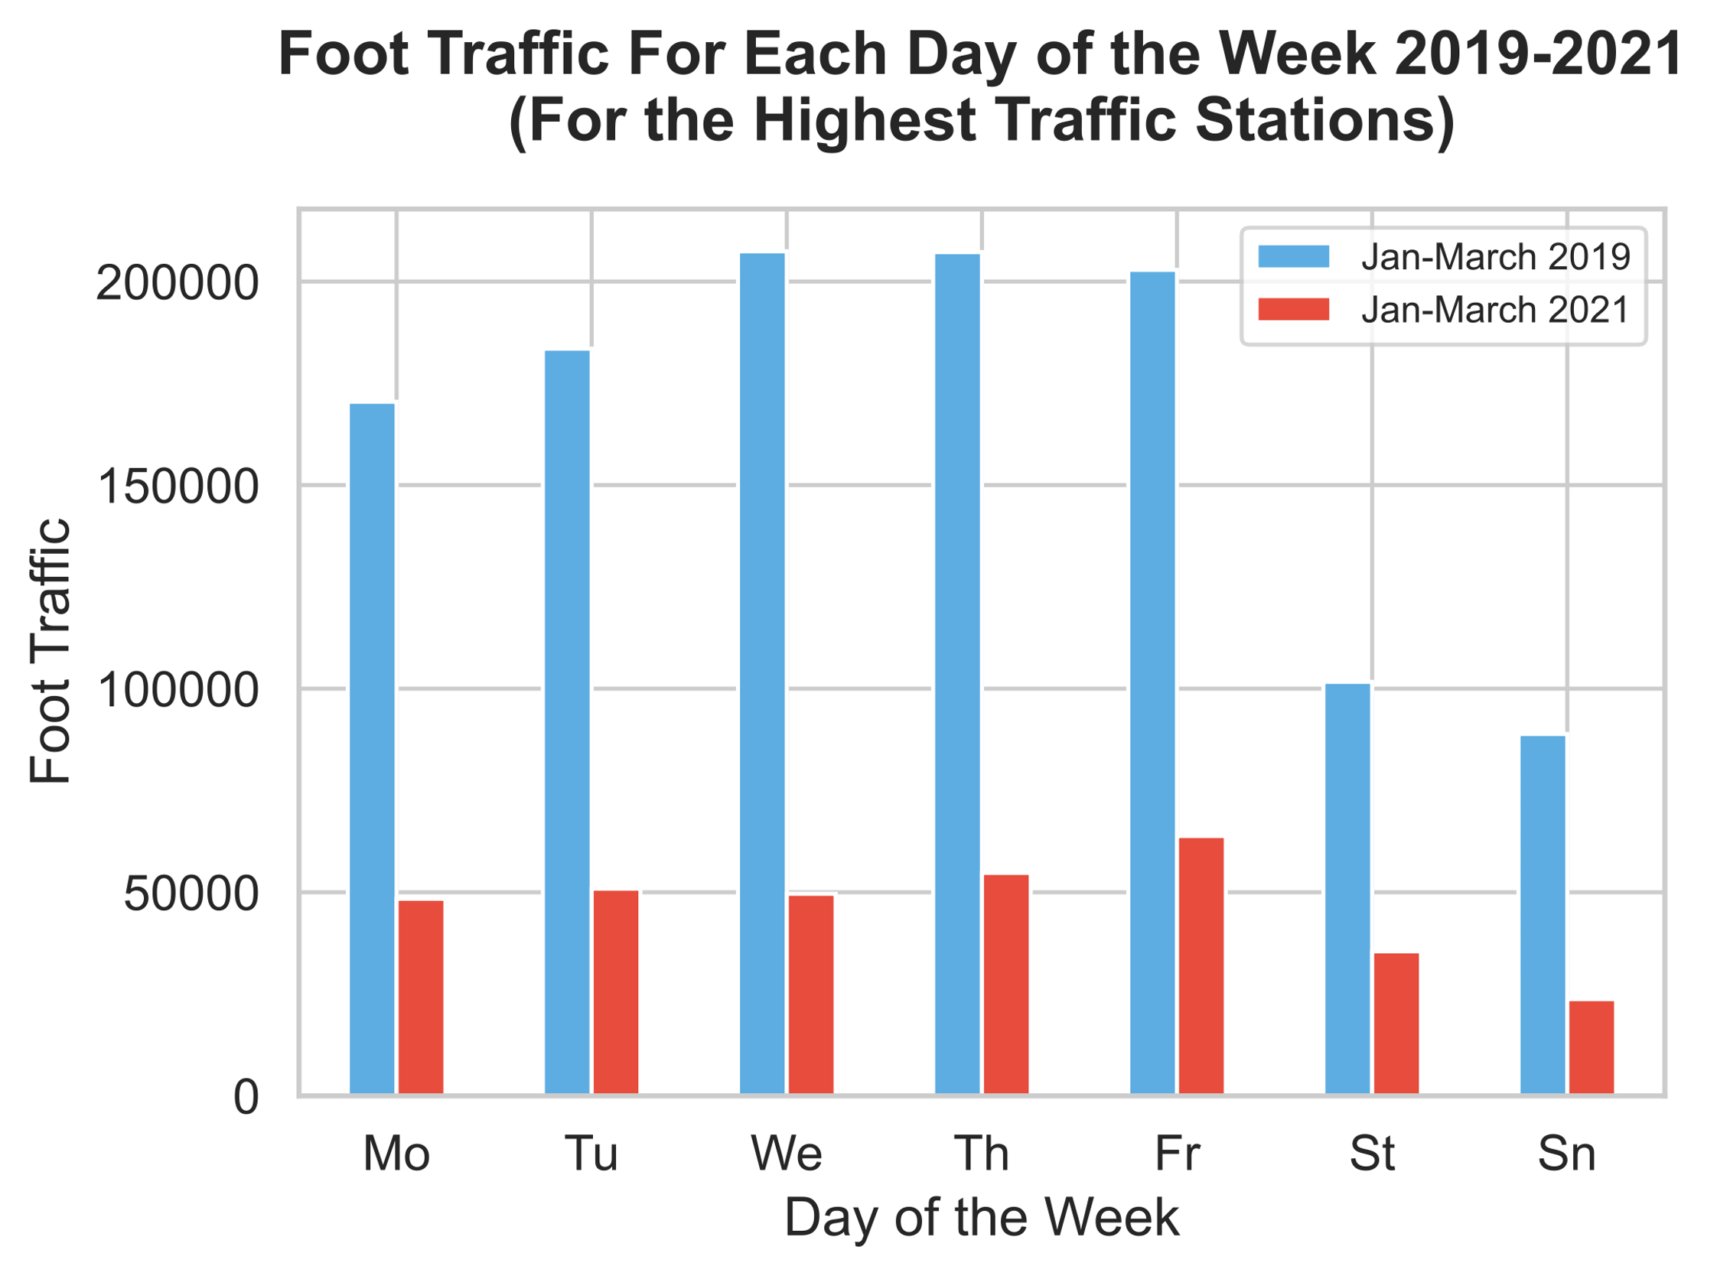

Slide 12
152,470 decrease
66,190 decrease
Notes:
76% decrease: 152,470; 65% decrease: 66,190

Slide 13
Insights
Highest Traffic Days
Foot traffic is highest during the working week
Foot traffic has decreased much more during the working week than the weekend during the pandemic
Consider increasing pricing of ad spaces on weekdays, especially once the pandemic ends
Note that the ad viewer demographic is currently composed of fewer non-essential workers

Slide 14
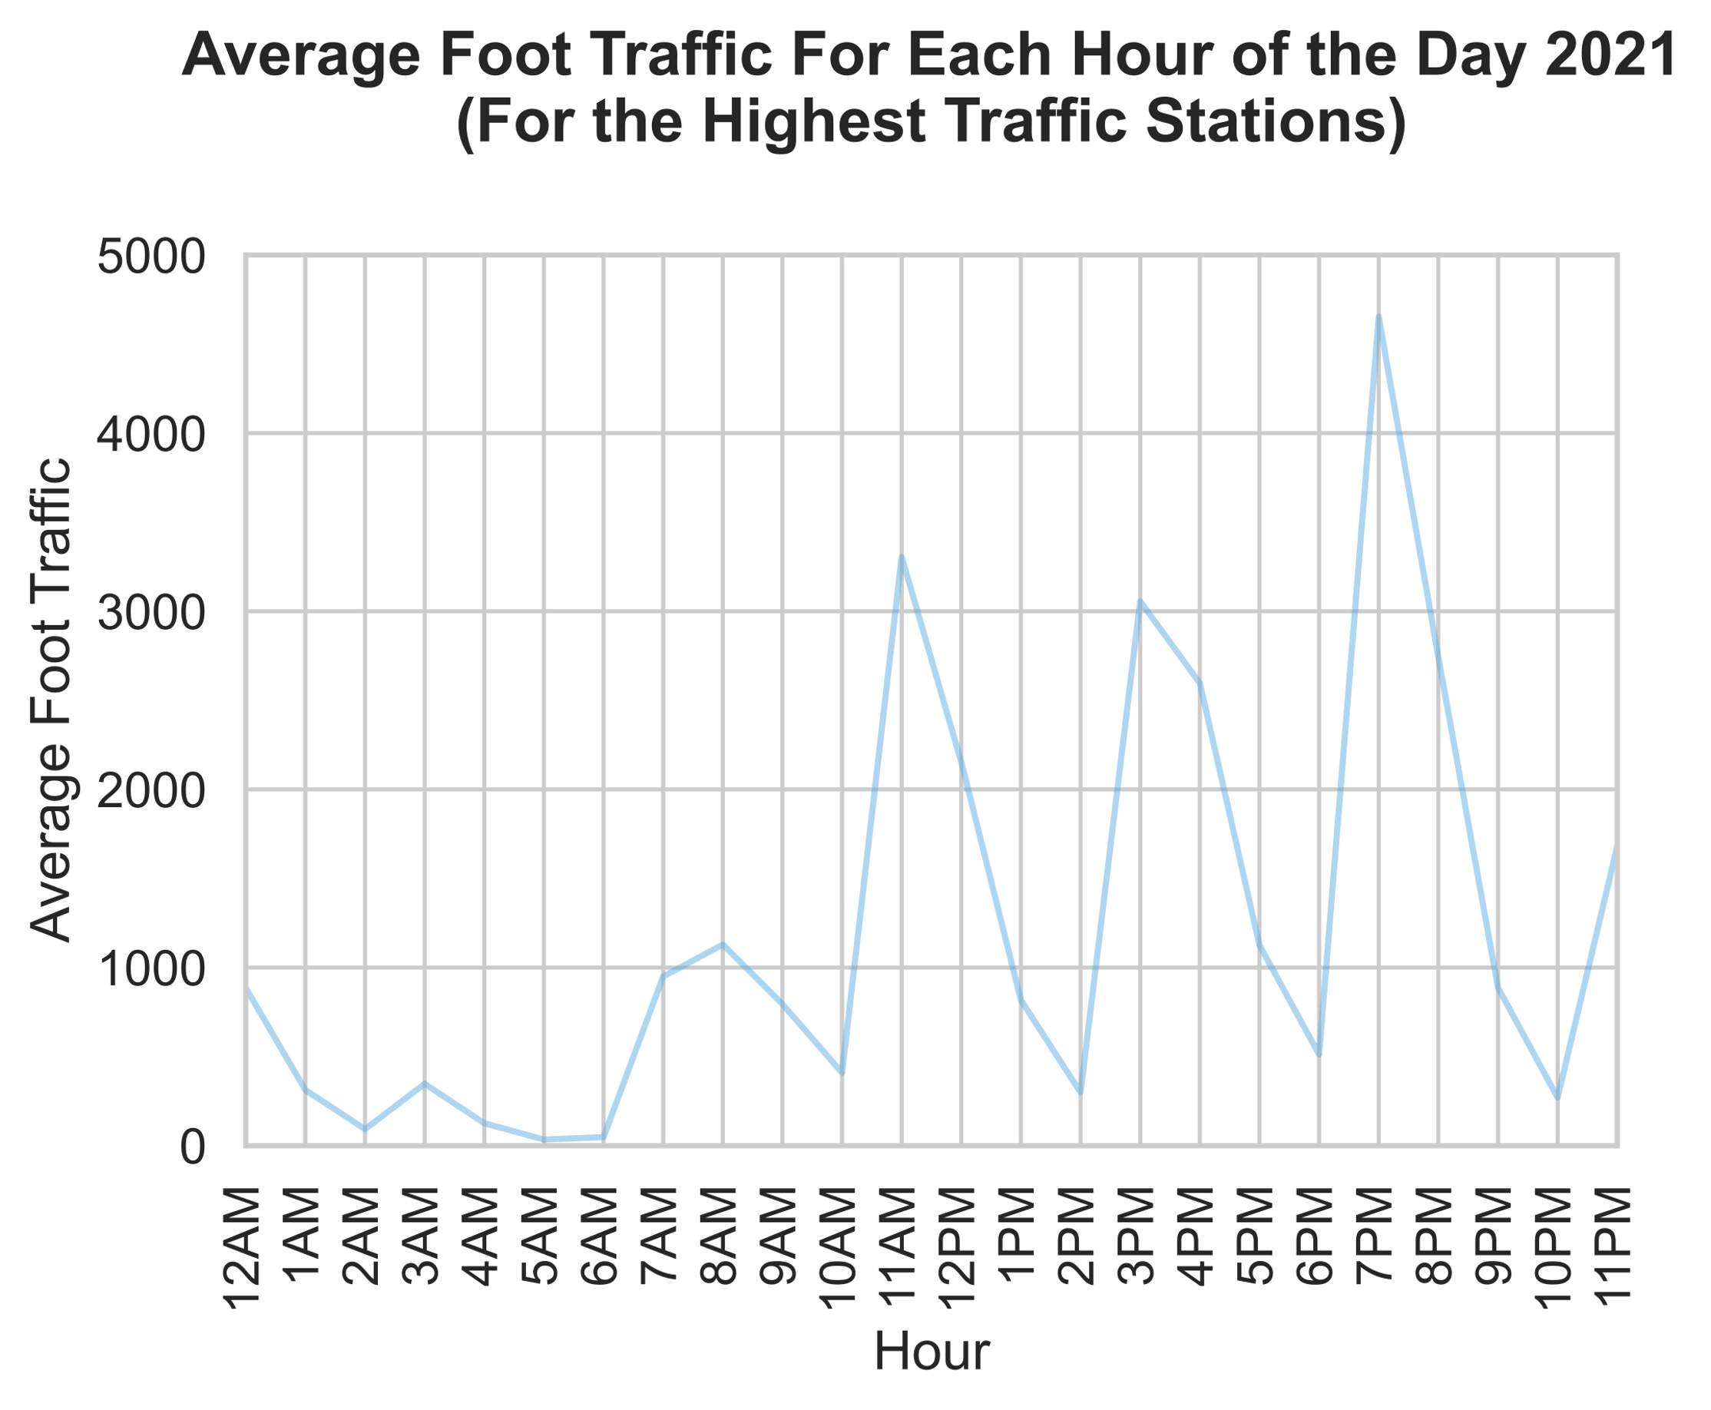
Analysis
Highest Traffic Hours
Foot traffic: sum of turnstile entries and exits

Slide 15
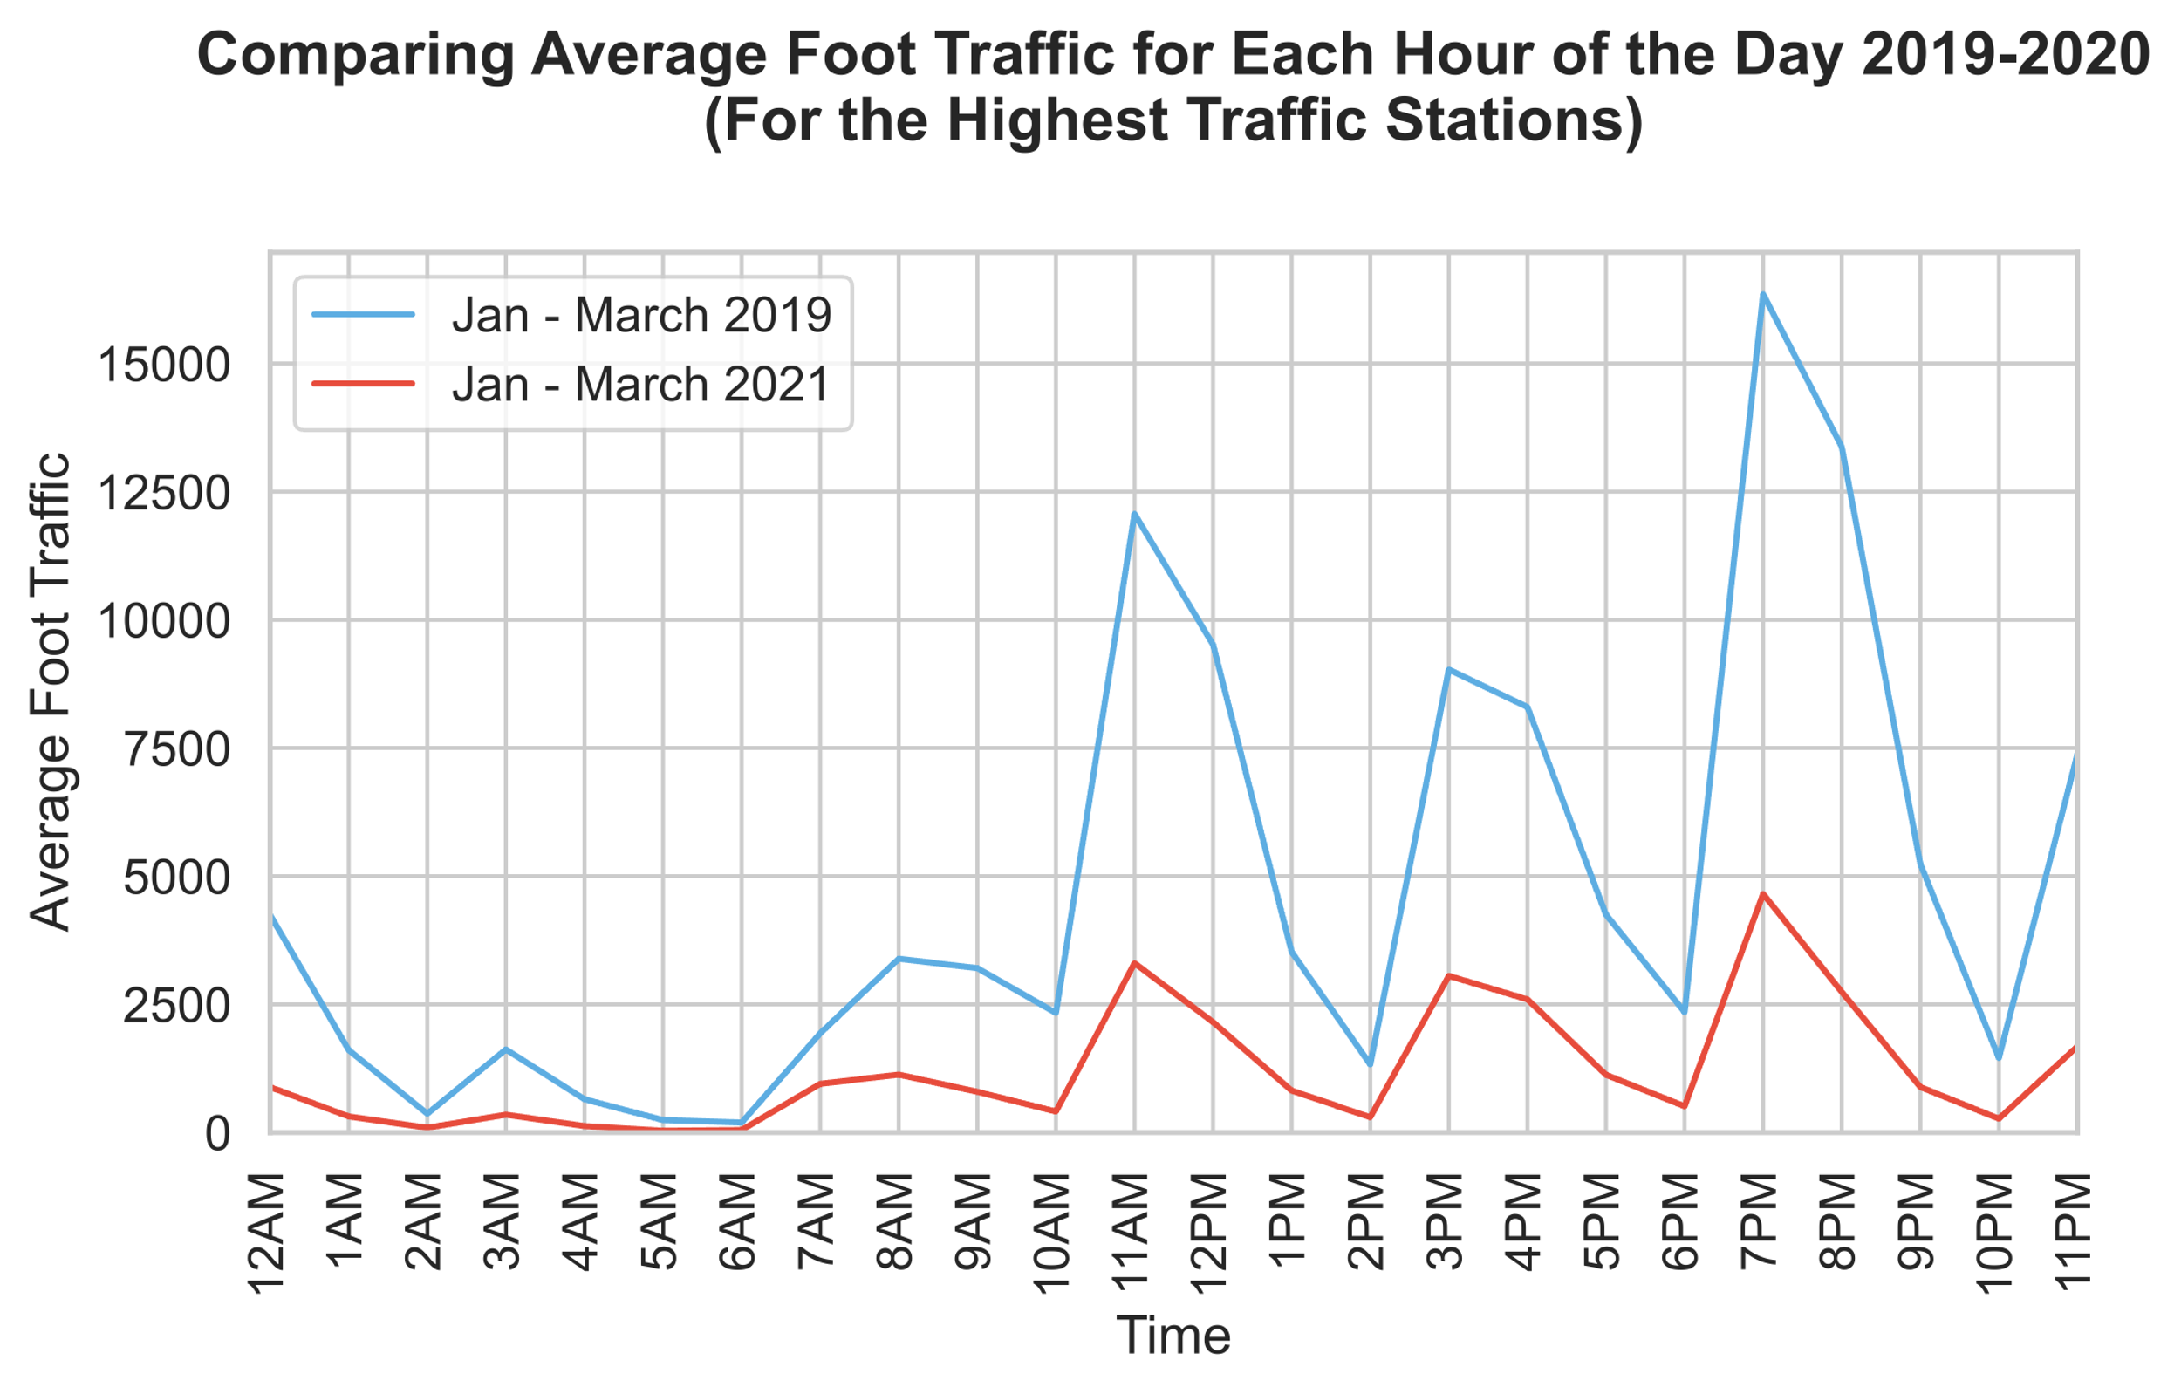
Notes:
Since readings are usually taken every four hours, assumably more readings are taken at 11am; so consider the peak at 11am to indicate a peak earlier in the morning.
Similarly, consider the peak at 7pm to indicate

Slide 16
Notes:
Since readings are usually taken every four hours, assumably more readings are taken at 11am; so consider the peak at 11am to indicate a peak earlier in the morning.
Similarly, consider the peak at 7pm to indicate

Slide 17
Insights
Highest Traffic Hours
Foot traffic is highest in the evenings
Foot traffic around midday is perhaps higher than expected
Consider increasing pricing of midday ad spaces

Slide 18
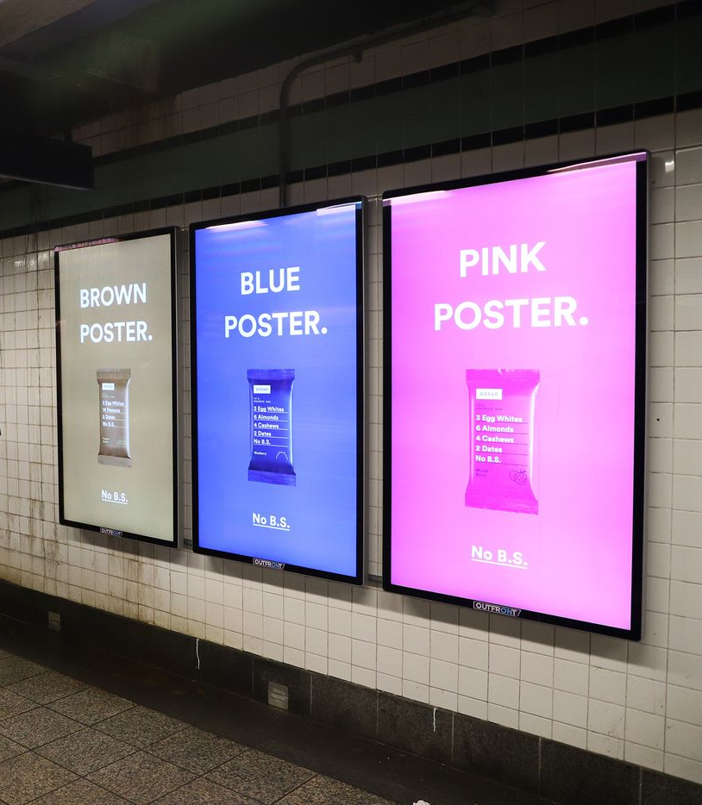
Conclusion
Liveboard Advertising Pricing
Consider increasing pricing of ad spaces in Manhattan stations located in non-commercial areas that are currently seeing high traffic
Consider increasing pricing of ad spaces on weekdays, especially once the pandemic ends
Consider increasing pricing of midday ad spaces

